Slide 1




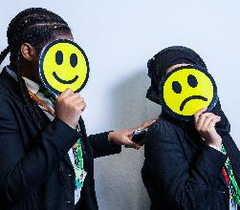
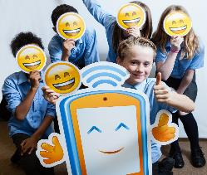
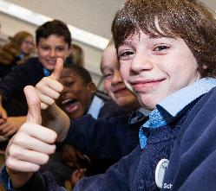
The Power of Image

Slide 2











There are now more ways than ever before to create, edit and share images and videos online.

Slide 3





Did you know…
On Instagram, photos showing faces are 38% more likely to get ‘likes’ than photos without faces
Images and videos get 8,500 likes and 1,000 comments per second on Instagram
400 million snaps are sent on Snapchat each day
1.8 million images are uploaded to the internet every day
1.8 million images are uploaded to the internet every day
The equivalent of 110 years of live video is watched on Periscope every day.
300 million photos are uploaded to Facebook every day
300 million photos are uploaded to Facebook every day

Slide 4


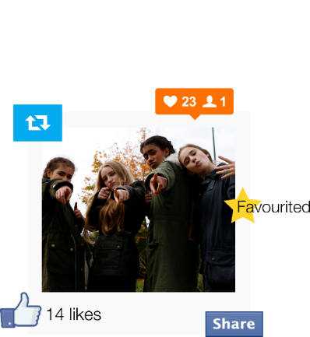
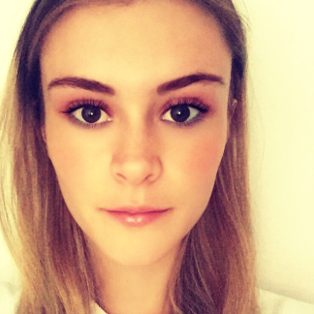

Why do people share images?
To share memories
To get noticed? (likes and followers)
To show people what you are up to
To raise awareness
To boost confidence?

Slide 5


What’s in a selfie?
A story?
Personal information
A message?
An invitation to contact or comment?
A challenge?
Creates an impression/affects online reputation
Geotagging data
Reality or fantasy?

Slide 6
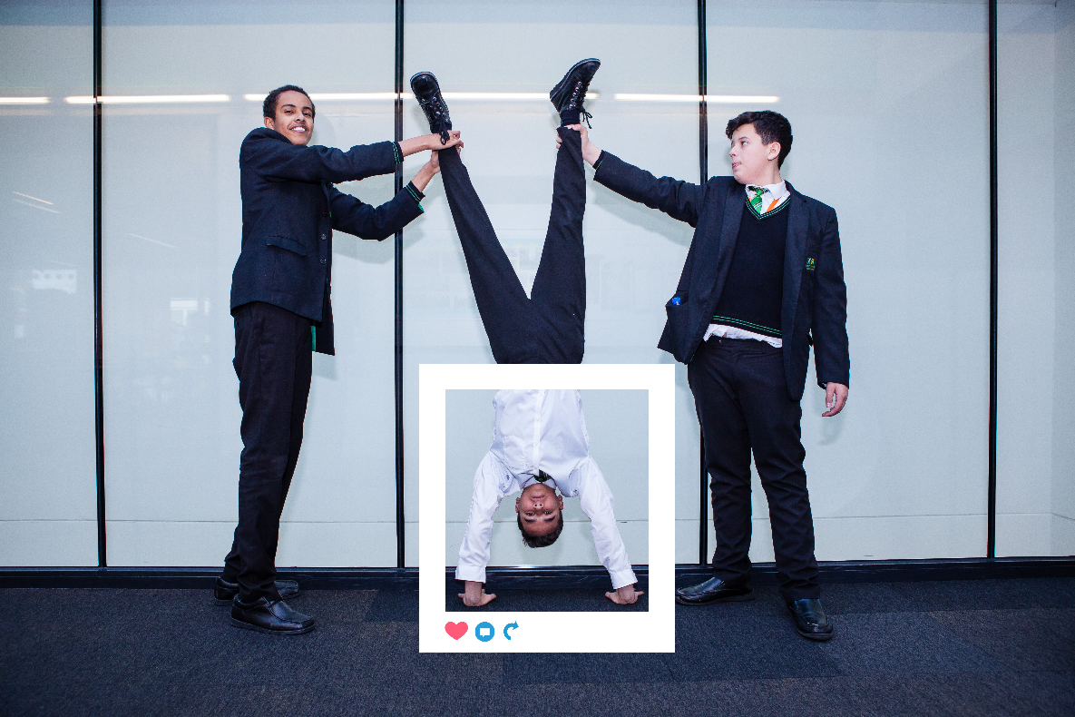
Is seeing always believing?

Slide 7
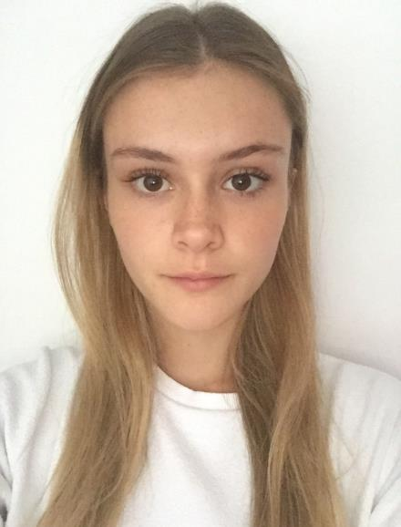
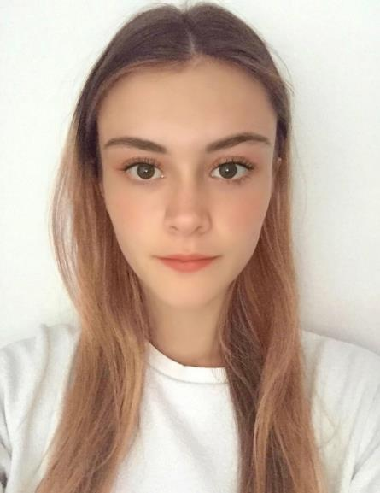
Is seeing always believing?
Real selfie
Edited selfie
Hair colour changed
Eyes are whiter
Face shape made slimmer
Makeup added
Skin smoothed out

Slide 8
Online Content
Advice
Discuss online experiences
Critical thinking is key
How does what they see impact on how they feel?
Online Conduct
Advice
Think before you post
How do their photos affect others?
Build an online reputation
Use privacy settings on social media

Slide 9
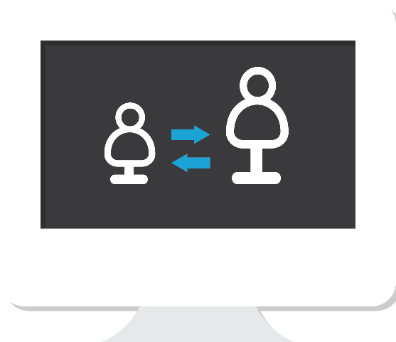
Online Contact
Advice
How many friends and followers?
Look after personal information
Why someone may make contact
Report and block offensive images, messages or users
Geotagging and geolocation settings

Slide 10

Sexting
Risks
Creating, distributing or possessing an indecent image of a child – against the law
UK Police position – first time offenders should not face prosecution
Emotional and psychological damage
Reputational damage
Online manipulation/extortion
www.saferinternet.org.uk/sexting

Slide 11
Sexting
Advice
Talk to your child about the risks
Seek help from the school/Police
ZIPIT app from Childline
‘So You Got Naked Online’ – advice for young people
Report suspected grooming to Police/CEOP
www.saferinternet.org.uk/sexting

Slide 12


What can I do right now?
Sign up to the UK Safer Internet Centre newsletter at:
saferinternet.org.uk
Open dialogue with your child
Family agreement
Consider filtering and blocking software
Think before you/they post
Understand the laws
Privacy settings and reporting
Save the evidence and report the incident
Know where to get help
Watch SID TV clips

Slide 13





Want more information?
We are happy to answer questions!
education@childnet.com
www.saferinternet.org.uk
www.childnet.com
Follow us
saferinternetuk
@UK_SIC

Slide 14


Safer Internet Day 2017 Education Packs
by UK Safer Internet Centre is licensed under a
Creative Commons Attribution-NonCommercial-ShareAlike 4.0 International License.

