Slide 1
Homework
Why do we do it?
How do we get better at it?

Slide 2
Homework
Why do we do it?
How do we get better at it?

Slide 3
Research says that homework…
… has a positive effect on student outcomes: in other words, students who do their homework well achieve more highly.
… increases students’ self-efficacy: in other words, students who practise the skill of independent work become more organised, more resilient, and more independent generally.
… has a boosting effect on motivation and self-belief: in other words, it is a virtuous circle, because students who regularly succeed in homework become more effective, motivated students.

Slide 4
Some reminders about how we learn:

Slide 5
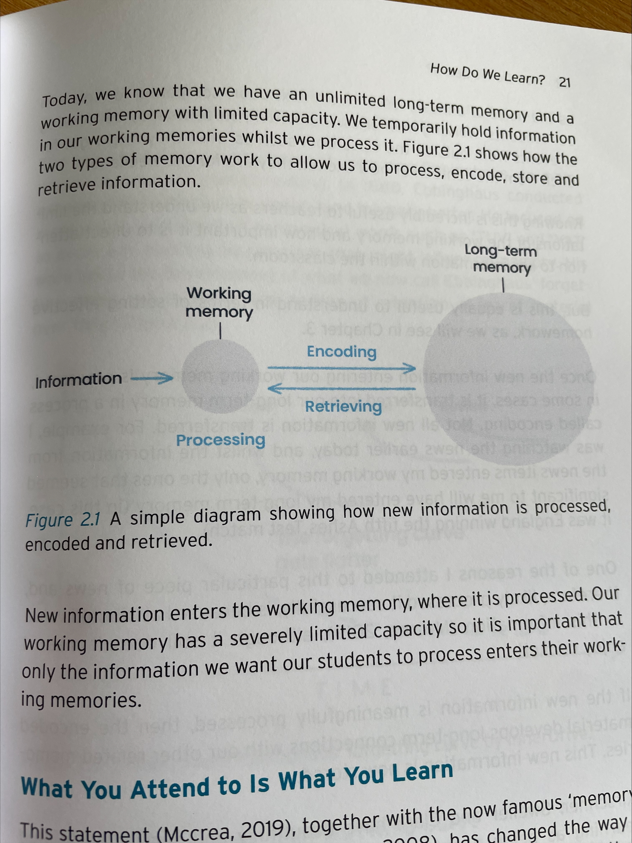
Some reminders about how we learn:
“What we attend to is what we learn”
(here, “attend to” means “pay attention to”).
“Memory is the residue of thought.”

Slide 6
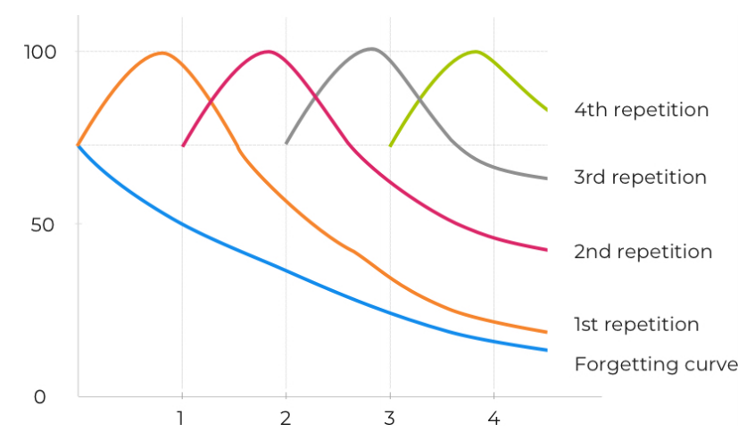
Some reminders about how we learn:
Interrupting the forgetting curve is essential if we are going to remember something. This is true of both explicit knowledge (facts) and procedural knowledge (how to do something, like write a paragraph or complete a calculation).

Slide 7
Completing regular homework means we spend a little longer each day paying attention to the thing we need to learn.
Our homework is designed to interrupt the forgetting curve. Homework allows you to revisit and retrieve regularly, making it more likely that you retain knowledge and improve skills.

Slide 8
So we see that homework helps us with our learning – and therefore with our progress.

Slide 9
So we see that homework helps us with our learning – and therefore with our progress.
Homework is also about habit building. You will need to learn the habits of revision, for future study, and the habits of independent and resilient perseverance for your future career.

Slide 10
Imagine for a moment a job that you think you might want to do in the future.
When do you think a person doing that job has to work independently?
What kinds of deadlines might they have to meet?
When do they have to persevere through something had?
When might they need to problem solve?
What learning do they have to do as part of that job?

Slide 11
Imagine for a moment a job that you think you might want to do in the future.
When do you think a person doing that job has to work independently?
What kinds of deadlines might they have to meet?
When do they have to persevere through something had?
When might they need to problem solve?
What learning do they have to do as part of that job?
Part of what you do when you complete homework is develop the skills and habits you will need to be successful later in life.

Slide 12
Forming good habits and solving problems is also motivating.
When you persevere through some challenging homework – and when you start to be increasingly successful at remembering knowledge or being able to do a skill – you start to believe in yourself more.

Slide 13
Homework
Why do we do it?
How do we get better at it?

Slide 14
A principle for life, and homework: habit is generally more powerful than will-power.

Slide 15
The theory of habit:

Slide 16
I put on my gym kit
I feel good after exercise
I exercise

Slide 17
My annual alarm goes off on my phone
I reward myself with a cup of tea
I book my car in for its MOT

Slide 18
What’s my cue to start my homework?
As soon as I get home? When my alarm goes off? When the school bell goes, do I go to homework club?
I tick it off as complete on Epraise.
I reward myself with free time.
Where do I sit? How do I start? Where is my phone? How long do I spend? How do I plan what I’m going to do?

Slide 19
We can help with habits
Wanting to use school computers?
Hoping to get organised?
Needing some extra help?
Needing a quiet space?
Mornings in S1: Monday, Wednesday and Friday from 8am.
Lunchtime in the Library, or in S1.
After school:
daily homework club in West Block
period 6 in S1 on Tuesday and Thursday

Slide 20
What do I do when the homework is difficult?
Identify causes:
What makes it difficult? Did I miss a lesson? Is it taking me a long time? Have I lost a sheet? Is there a key concept I’m not understanding?
Seek the right support:
Could I ask a friend who was in the lesson? Have I communicated the problem to my teacher? Could I attend homework club?
Problem solve:
What resources do I have access to – in my book, on Epraise, on Seneca, etc. – to help me with the problem? What else might help me?
Make an attempt:
Even if I’m not sure I’ve got it right, some effort in the right direction is good for my learning.

Slide 21
I want to learn to get more organised. How do I begin?

Slide 22
I want to learn to get more organised. How do I begin?

Slide 23
I want to learn to get more organised. How do I begin?
Talk to your form tutor about habit building and make a decision about what habit you want to begin.
Review the habit in a week, and then in two weeks, with your tutor. Tweak where you need to. Reward yourself when it’s going well!

Slide 24
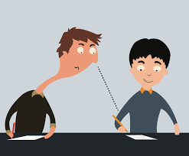
A poor strategy:
Remember why we do homework:
to achieve highly by paying attention to, and thinking hard about, the right thing
to increase independence, resilience, problem-solving and organisation
to boose motivation and self-belief by becoming increasingly successful.
Discussing homework is a good idea. Copying homework is not. Researching ideas is a good idea. Using AI to generate homework is not.
Ultimately, cheating just won’t be tolerated – don’t try it.

Slide 26
Homework
Why do we do it?
How do we get better at it?

